Slide 1
Team106online
Sprint 3

Slide 2
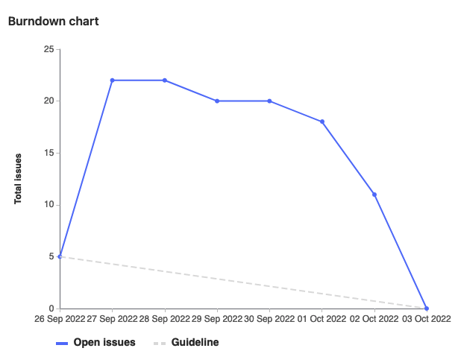
Sprint Progress

Slide 3
What Went Well
What To be Done Differently
Initial planning and breakdown of work
Technical design to allow for independent work and easy merge
Assign tasks sooner
Always have two meetings to go over sprint progress

Slide 4
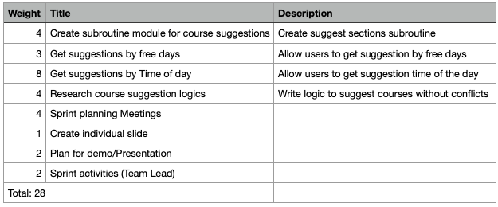
Team Member: Alif Merchant
Work Highlights
Mainly worked on excel sheet macros that suggest sections
Had Code reviews with other team members

Slide 5
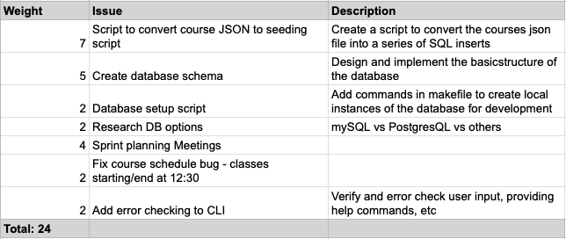
Team Member: Samuel Guilbeault
Work Highlights
Create scripts to spin-up the database infrastructure and schema
Scripts to parse courses json into SQL insert statements
CLI bug fixes with Hyrum

Slide 6
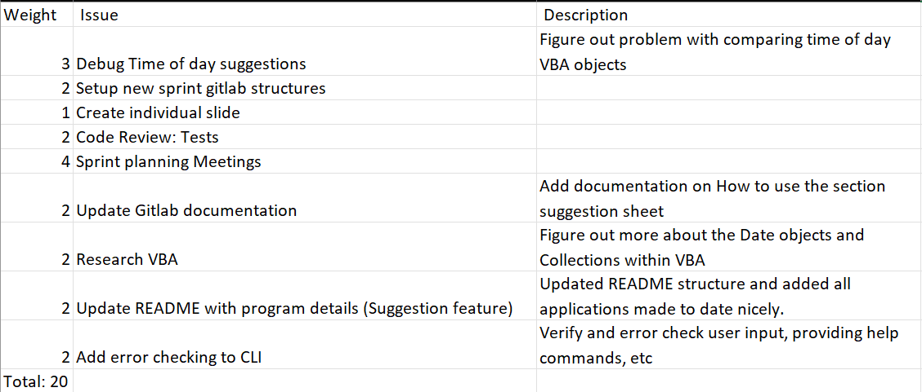
Team Member: Hyrum Nantais
Work Highlights
Error checking input in the course searcher
Help with debugging Time of day functions with Rehan, Alif, Muhammad
Restructure README and documentation to progress done so far

Slide 7
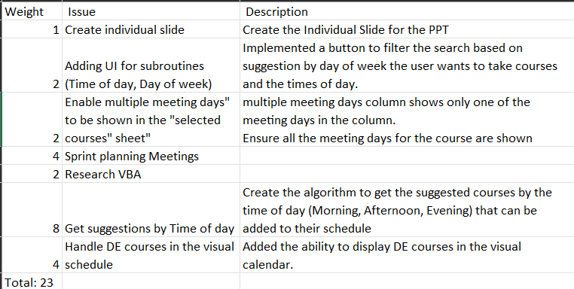
Team Member: Rehan Nagoor
Work Highlight:
Created the script/algorithm to get the suggested courses by the time of day e.g. Morning, Afternoon, Evening.
Created the UI for the user to choose the options for the suggested type of courses to be added.
Fixed a bug in the selected courses sheet regarding the meeting days
Added way to show DE courses in the schedule

Slide 8
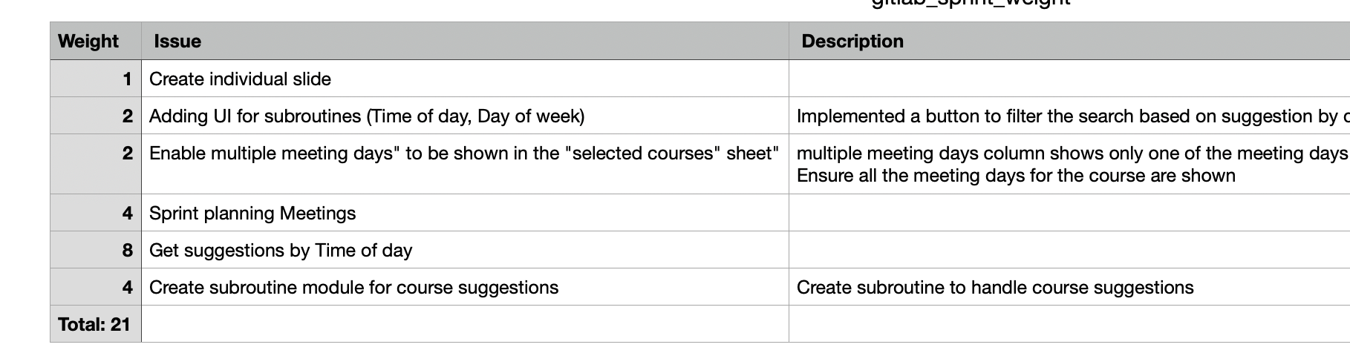
Team Member: Muhammad Salmaan
Work Highlights
This week my weight for the total work done was 21 weights.
My highlight : worked on and helped with the get suggestion by time of day and helped with the UI for subroutines.
Had team meetings and reviews this week and pair programming.

Slide 9
Team Member: Parker Carnegie
Work Highlights
Participated in code reviews
Created documentation for suggestion engine (Wiki)
Further researched VBA
Helped with CLI input validation with Caleb
Total weight: 21 (10.5 hrs)

Slide 10
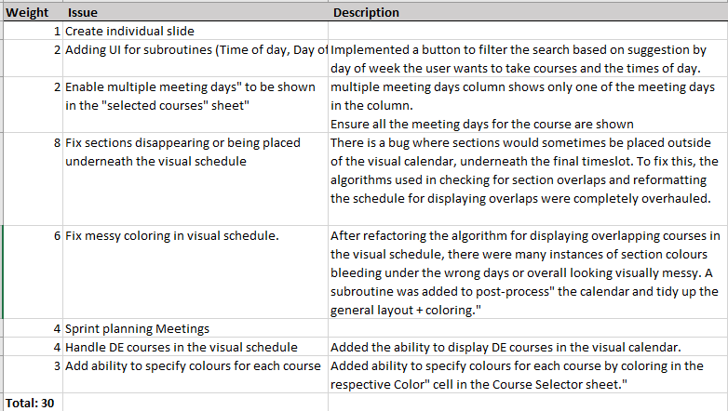
Team Member: Ivan Odiel Magtangob
Work Highlights
Team meetings
Refactoring visual schedule to fix major issues
Polishing + adding new features to visual schedule
VBA Code review

Slide 11
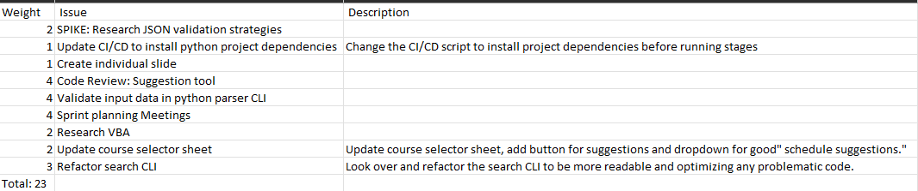
Team Member: Caleb Beere
Work Highlights:
Sprint planning meetings
Adding JSON validation to parser CLI in accordance with JSON 2020-12
Code Review of the Spreadsheet suggestion tool
Updating CI/CD script to install project dependencies before running tests

Slide 12

Demo time!

